Slide 1
Master Thesis Introduction Visual Analytics Framework for High Dimensional Data Streams
Khan Hafizur Rahman Supervisors
Matr-No 360142 Dr.Matthias Jarke, Dr.Christoph Quix
Hafizur.Rahman@rwth-aachen.de Arnab Chakrabarti

Slide 2
Topics I focussed:
Dataset
Architecture of the solution approach
Evaluation
Thesis Proposal Writing

Slide 3
Dataset
Availability of Free Online Stream API
Cryptocurency of data having 12 features
Historical Financial Data Set
New York Stock exchange having more than 70 features
Try to Focus on Datasets which Change on Time
Selected : Historical Data Set
70+ dimensions are not High Dimensional for develop a model but from visualization perspective it is.

Slide 4
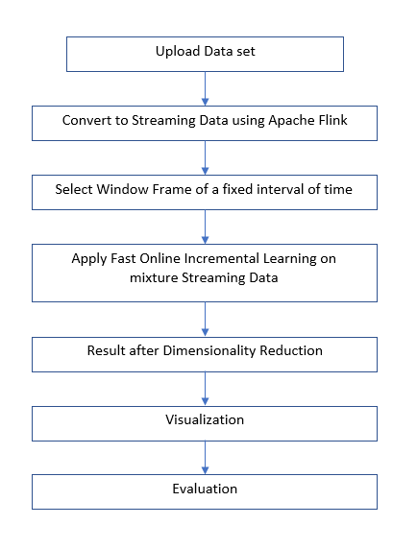
Solution

Slide 5
Evaluation
Comparison of Vizualisation without dimensionality reduction and applying dimensionality reduction
Comparison of performance of the algorithm between using incremental data and streaming data
Scalability of the Framework

Slide 6
Next 2 week
Complete proposal writing & give presentation
Modification of the work based on todays feedback

Slide 7
Thank you!

